Slide 1

Shopping with your eWIC card

Slide 2
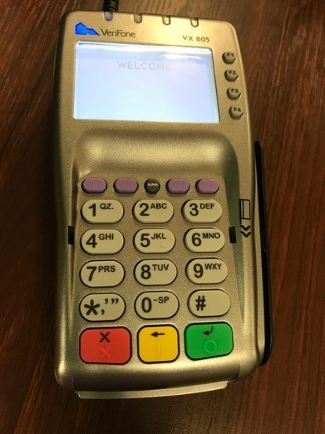
Setting your PIN
Choose a 4-digit PIN that is easy for you to remember, but hard for others to guess.
Do not write your PIN on the card or on anything you keep with it.
Anyone can gain access to your benefits if they have the PIN. Those benefits can not be replaced.
If you forget your PIN, call the number on the back of your card, or call your WIC clinic.

Slide 3

Keep card safe
Keep your card and bring it with you each time you come to the WIC office. You will use it again to access future benefits.
Keep it away from magnets and electronics such as cell phones.
Please keep it clean and dry. Try to keep it out of direct sunlight. Please do not bend your card.

Slide 4
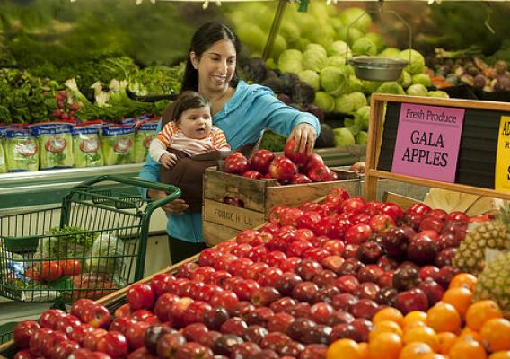
Cards can be used at designated Kansas WIC authorized grocery stores
Use the vendor list provided by WIC.
Use WICShopper app to find nearest grocery store.
Look for “We accept eWIC cards” sticker on the door of stores.

Slide 5
The shopping list will show your family’s food benefits
Your benefits become available on your first use date at 12:01 a.m.(just after midnight).
Food benefits that have not been purchased by the last use date do not carry over to the next benefit period.

Slide 6
What if my PIN doesn’t work?
Change your PIN by calling the number on the back of your card.
If you enter the wrong PIN 3 times in a row, your PIN will be locked.
Call your local WIC clinic to unlock it or wait until midnight when it automatically unlocks. Then re-set the PIN.

Slide 7
If your card is lost, stolen, or damaged
Call your WIC clinic as soon as possible. If after business hours, leave a message.
The card will be deactivated by the next business day.
You will need to make an appointment to replace your card.

Slide 8
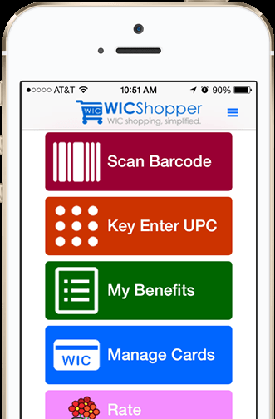
Know your food balance when you go to the store
Use the WICShopper app.
Use the last register receipt.
Call the 1-800 number listed on the back of your card.
Visit www.ebtedge.com.
Access the WIC Client Portal.
You may also get a printout from a cashier.

Slide 9

Shopping with eWIC
Please remember to be patient - eWIC is new for cashiers too!!

Slide 10

At checkout
Separate your WIC foods from your other groceries during your first few shipping trips. This will help you know which foods are paid for by WIC and which ones will need another form of payment.
Use your eWIC card before all other forms of payment, including your SNAP card.
Swipe your eWIC card and enter your PIN when asked.

Slide 11
A mid-receipt will be printed or displayed
This will show WIC- approved purchases.
It is important to review this receipt.

Slide 12
What if one of my food items isn’t accepted?
Start by checking the WICShopper app to make sure the food is in your account and you have the correct brand or size.
If you think it should be allowed but it’s not going through, take a picture of the barcode and report it through the app or at the WIC clinic.
If you choose to purchase these foods on your own, WIC cannot reimburse you.
Contact your local WIC clinic if you have any questions.

Slide 13
Your receipt will show the remainder of your balance
Cashiers cannot override the system!
With eWIC, the register will determine the items that can be purchased based on approved products and the foods specifically prescribed to you within the current benefit period.
The system will not allow cashiers to override it.

Slide 14
No self check-outs
You are not able to use self-checkout lanes with your eWIC card.
If these are the only lanes open please get an employee and request they open a fully staffed lane.

Slide 15

Thank you for participating in Kansas WIC!

